Slide 1
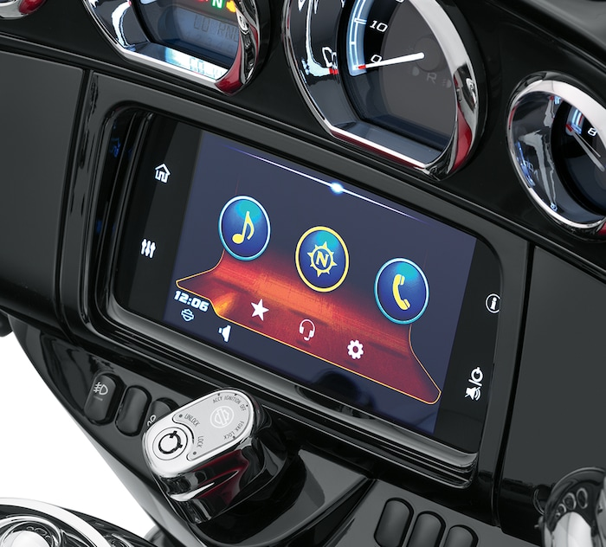
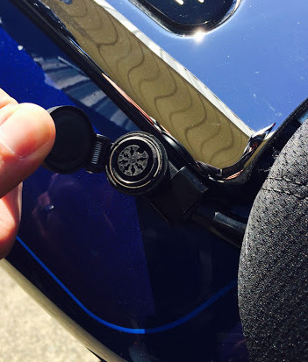
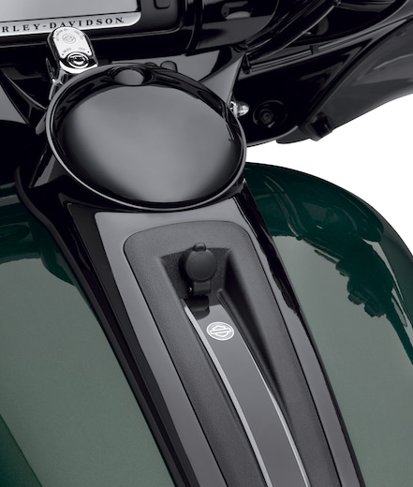
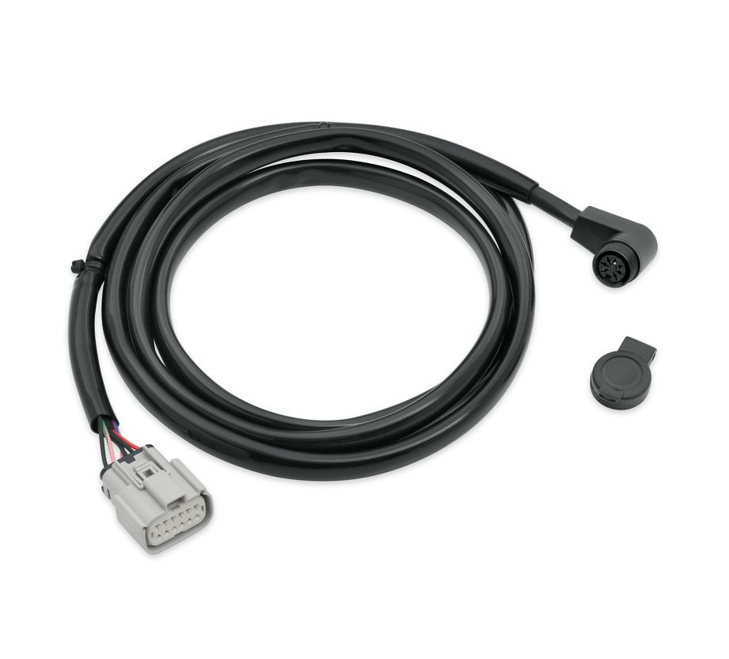
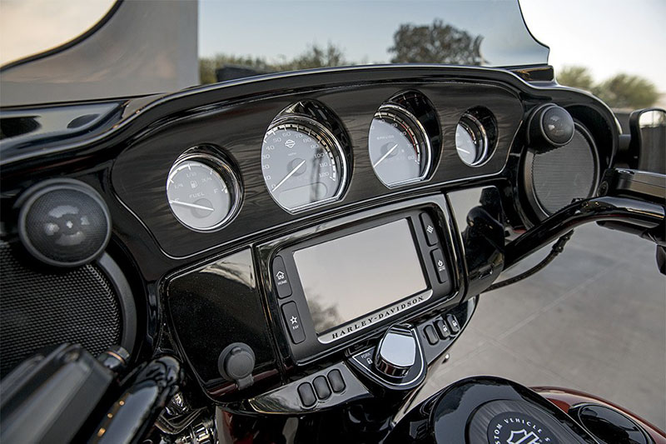
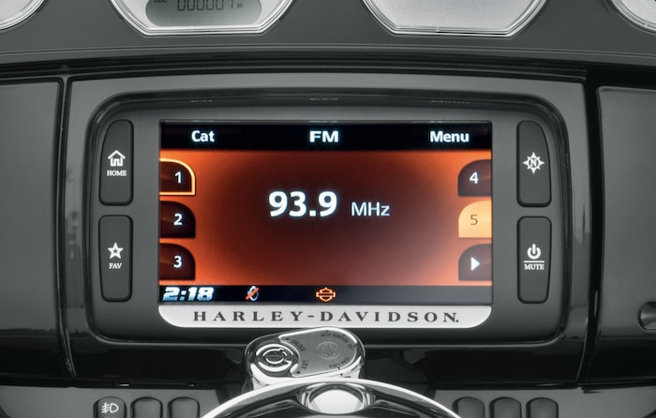
If you have this radio Harley Boom GTS
And have a wired communication port like this
Simply plug this into the Port and your radio will have Apple Carplay or Android auto no Harley programming required. “Plug and Play”
Road glide or Street glide with optional Boom! Audio Communications HD PN/ 69200865
2014-2020 Ultra classic Non CVO, NO WHIMS
HD PN/ 69200865
2015-2017 Road glide CVO or Street glide CVO, NO WHIMS
Not compatible with Harley Boom Box

